Slide 1
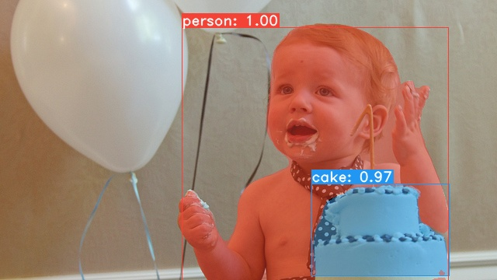
Yolo mask
2019.04
Huaiyu Zheng, Zhiyang Liu, Yaofei Wang

Slide 2
Motivition
&
Background

Slide 3
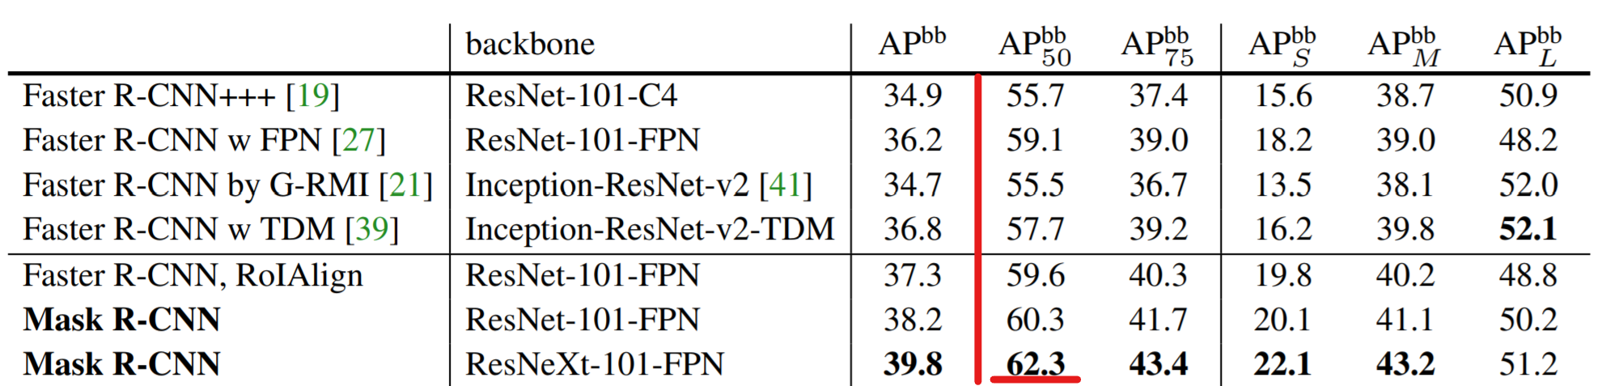
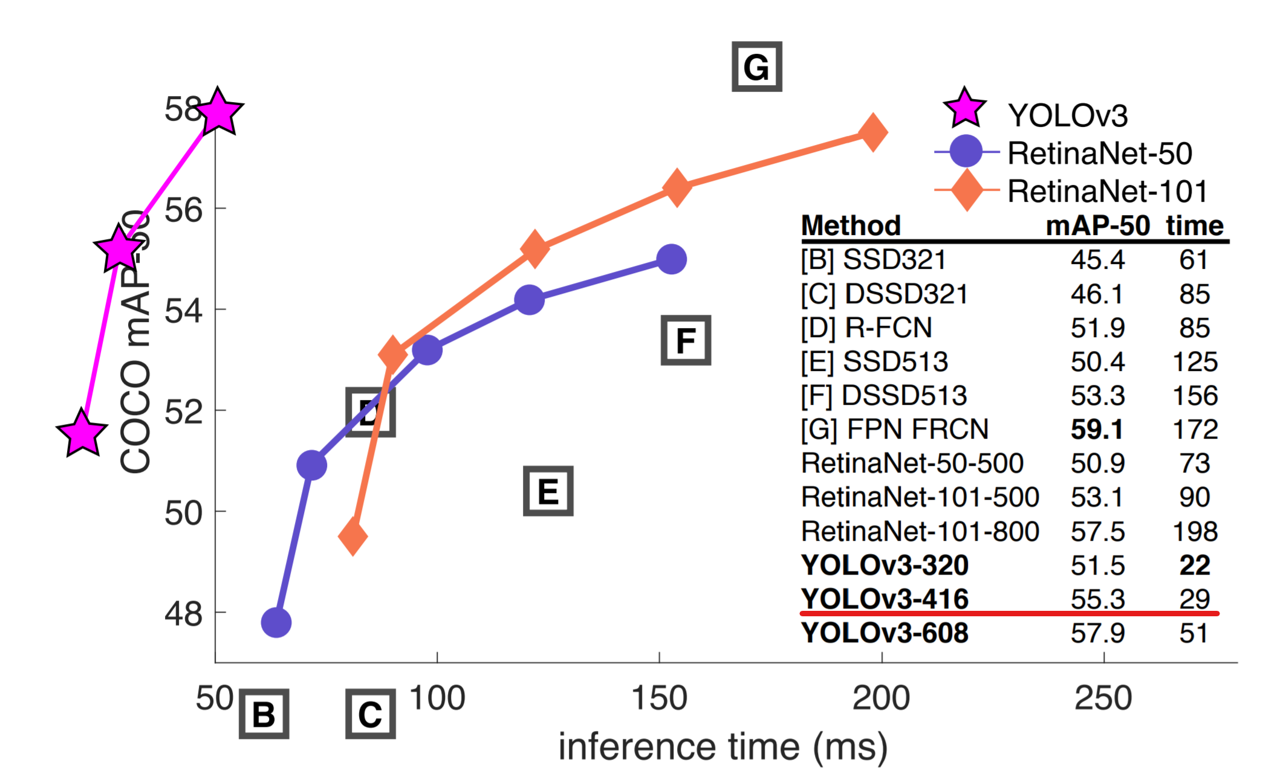

Motivation
62.3 APbb with ~5 FPS
55.3 APbb with 30+ FPS
Lower mAP but with higher FPS?

Slide 4
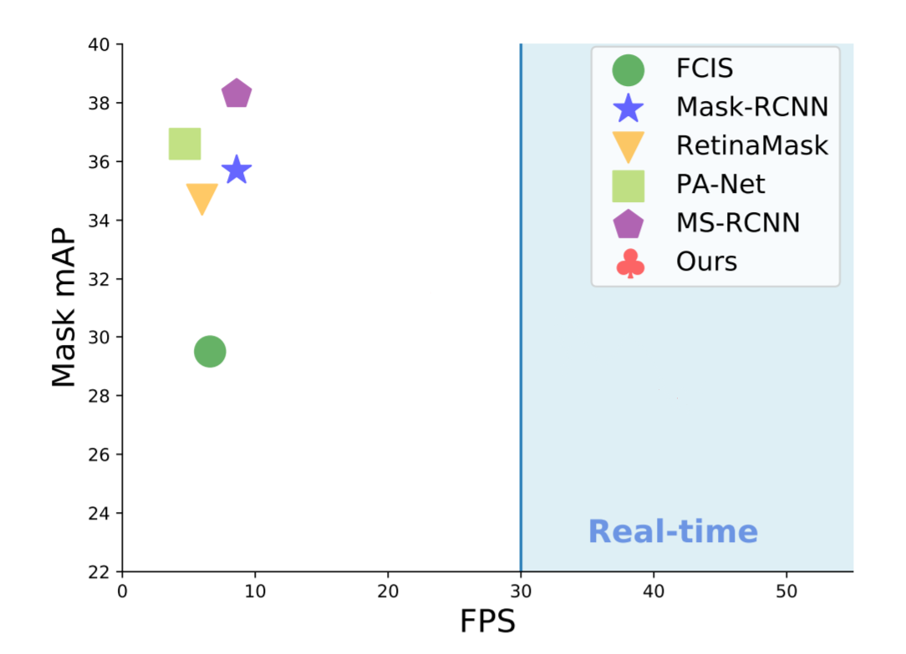
Our Goal
Acceptable mAP with high FPS
Two-stage：
R-CNN → Fast/er R-CNN
→→Mask R-CNN
One-stage：
Yolo → Yolov3
→→Yolo-Mask?

Slide 5
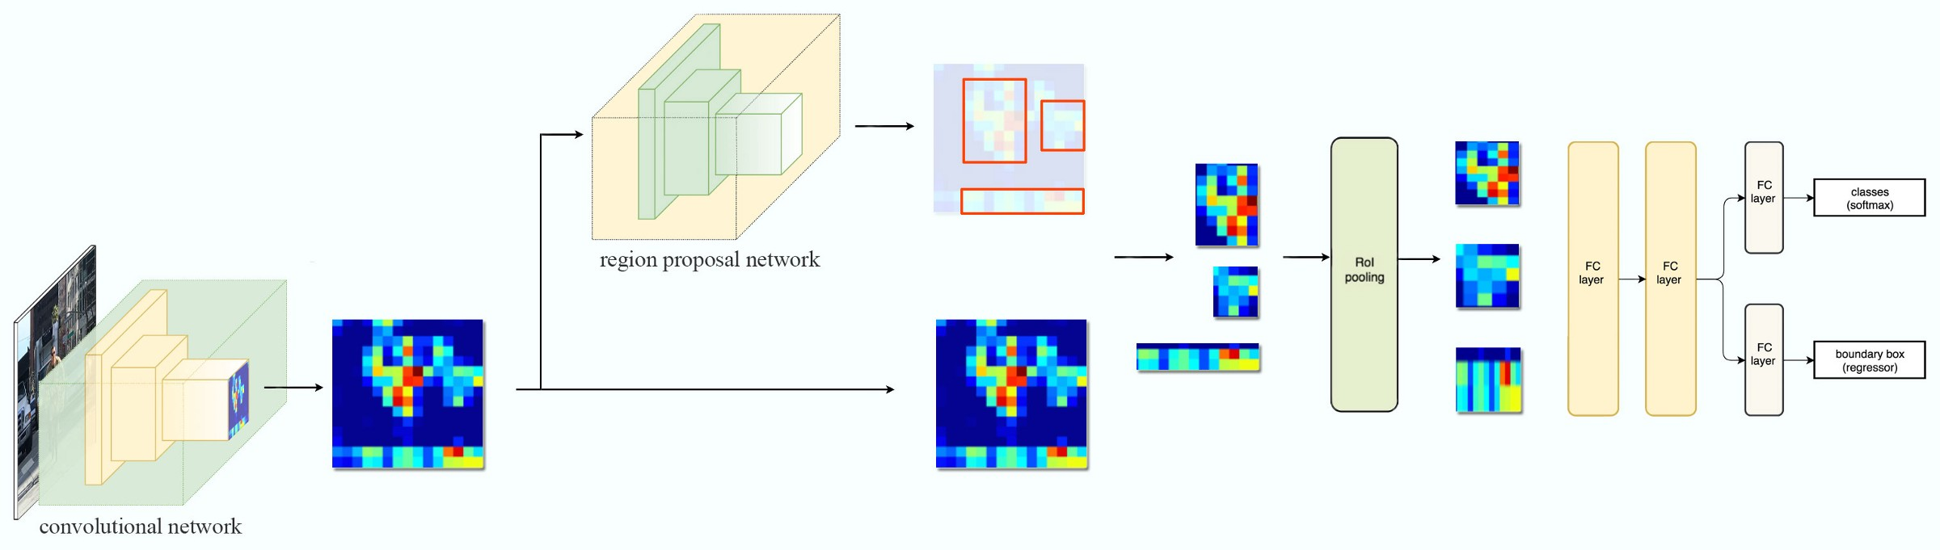
Background
Mask R-CNN’s structure
Improved Convolution Network-----ResNeXt & FPN
Using RoIAlign layer to get better RoI
Added the mask prediction branch
Good Feature Map is the Foundation

Slide 6
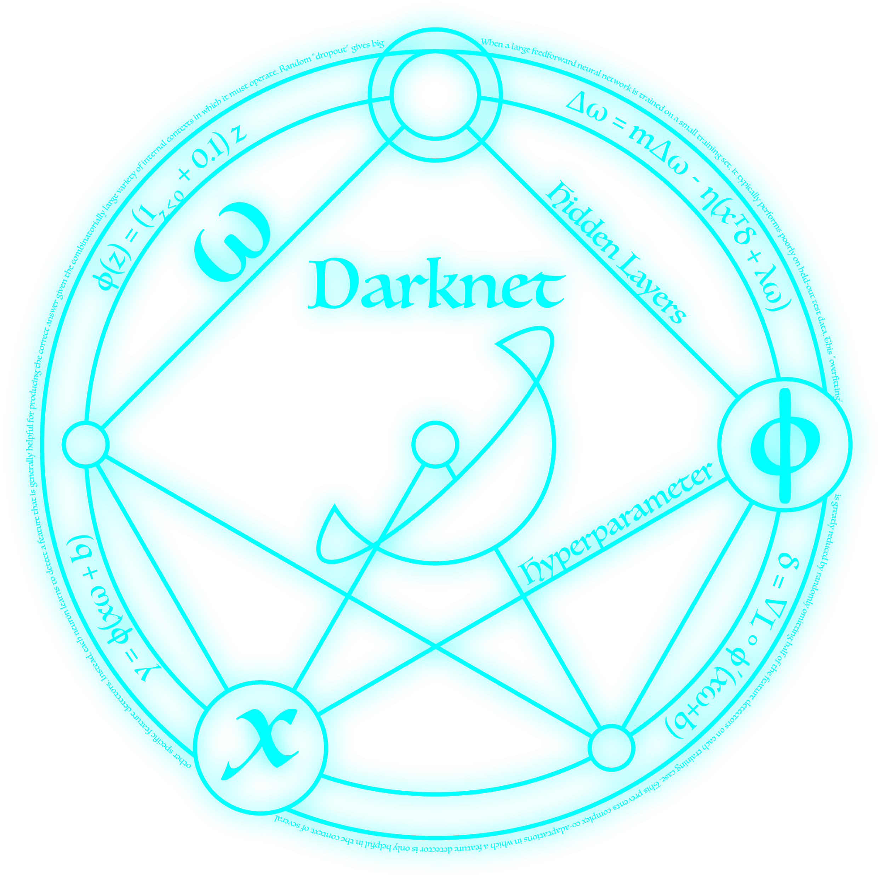
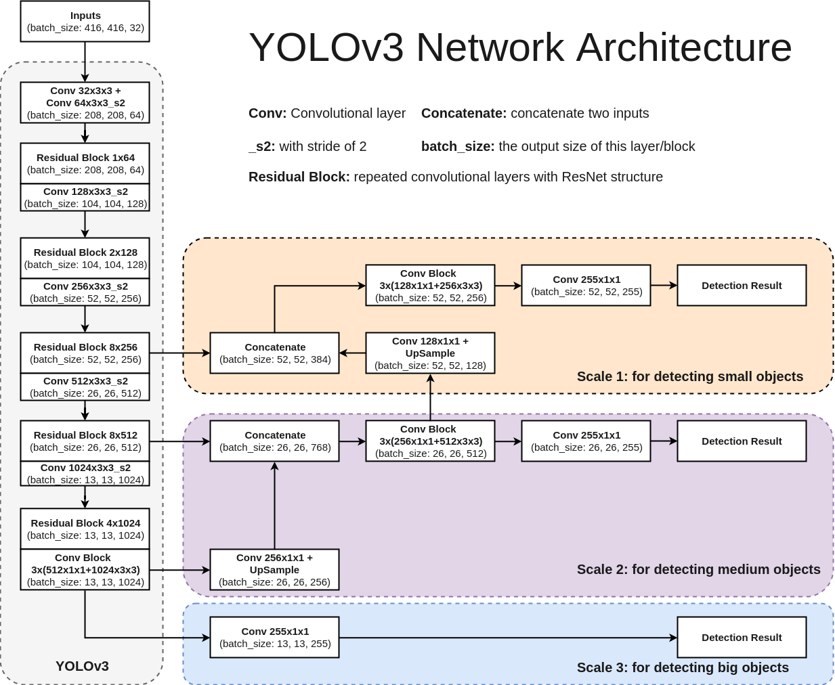
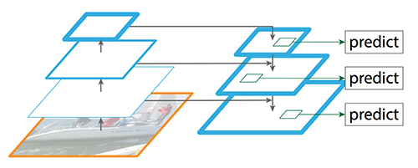
Background
Darknet 59

Slide 7
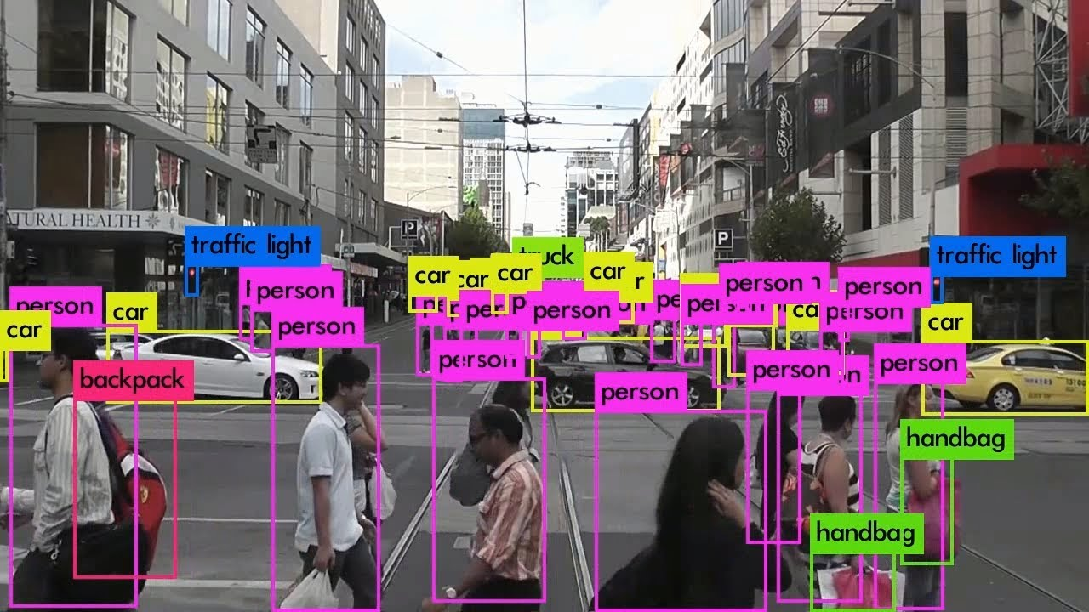
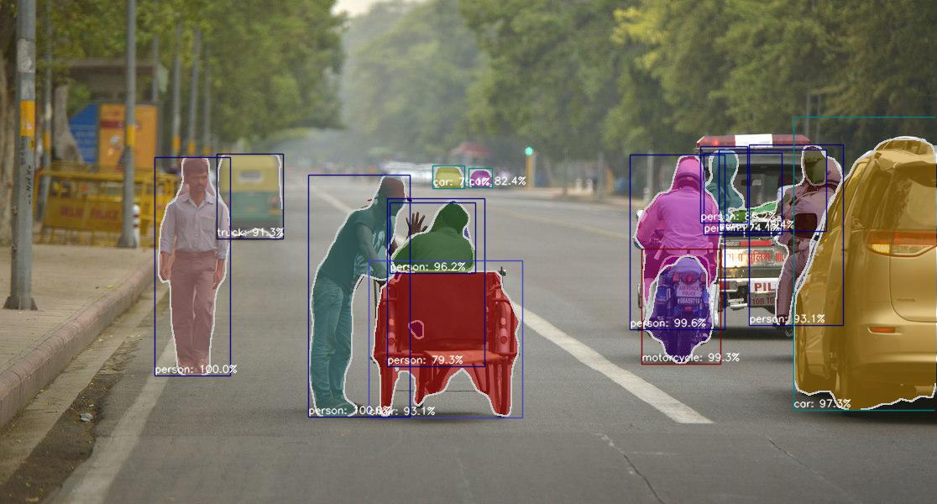
Background
Object detection
Instance Segmentation
YOLOv3: An Incremental Improvement
Mask R-CNN

Slide 8
Network Design

Slide 9
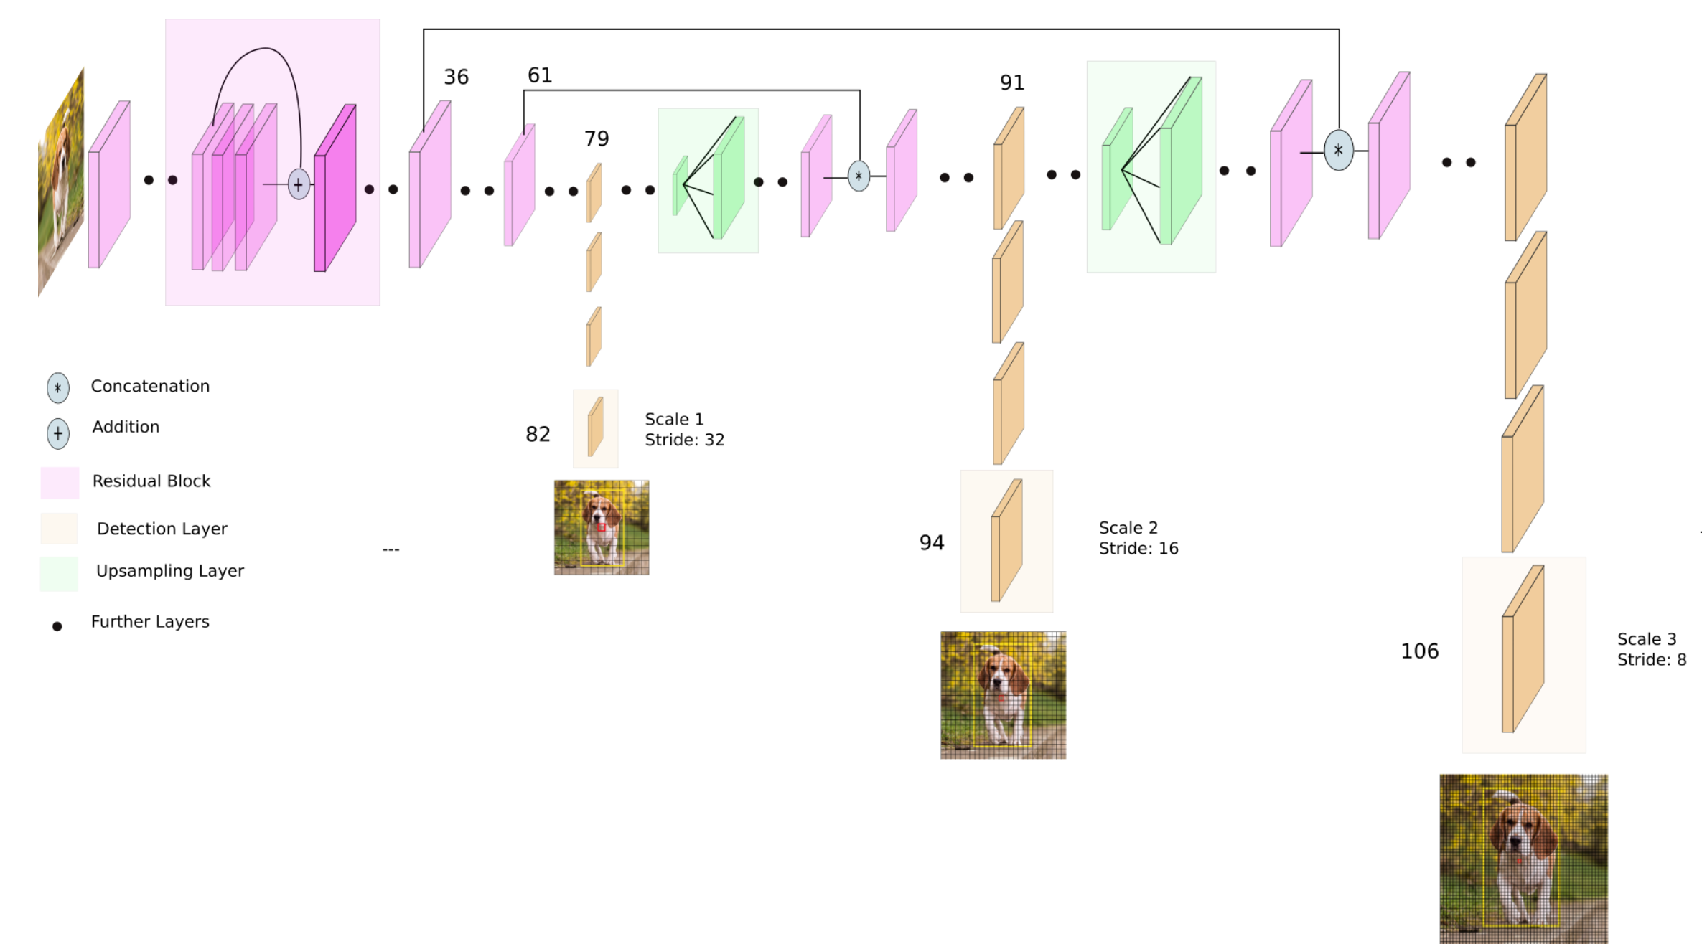
How this work
bboxs
feature maps
13x13
26x26
52x52

Slide 10
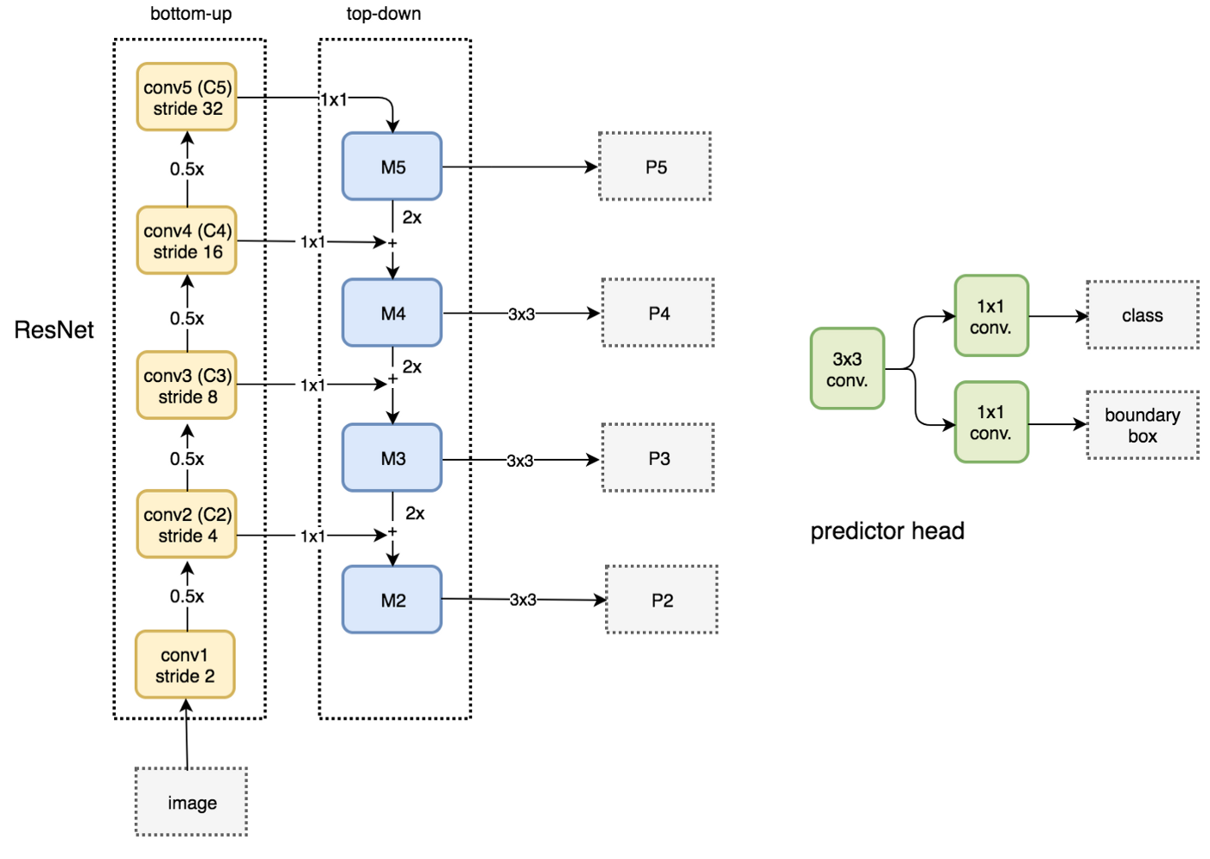
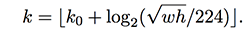
FPN
K0 = 3
Notes:
The author sets k_0 to 4, which means that the ROI of w×h=224×224 should be cut out from P4.
Assuming the scale of the ROI is less than 224 (say 112 * 112), k = k_0-1 = 4-1 = 3, which means that it is generated from a higher resolution P_3.
In addition, the k value is rounded to prevent the result from being an integer.

Slide 11
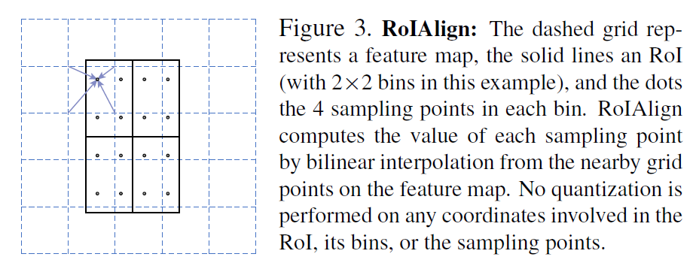
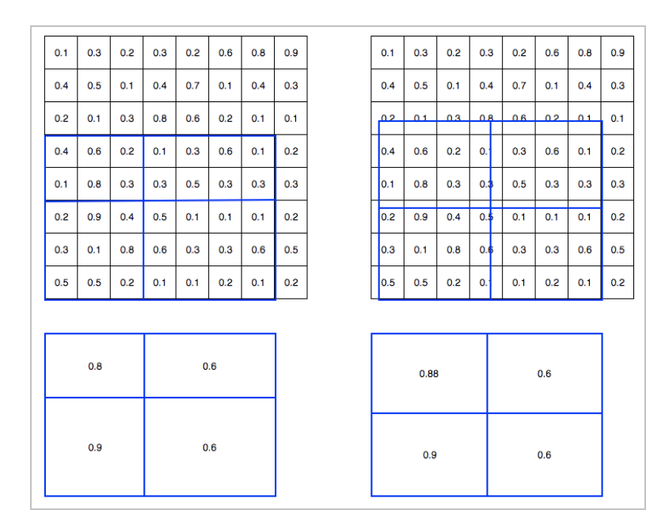
ROI align

Slide 12
How this work
ground
truth
mask
Cropped feature
predicted
mask
loss
RoiAlign
C1
C4
C5
C2
C3
deconv
Binary Cross Entropy
the mask branch

Slide 13
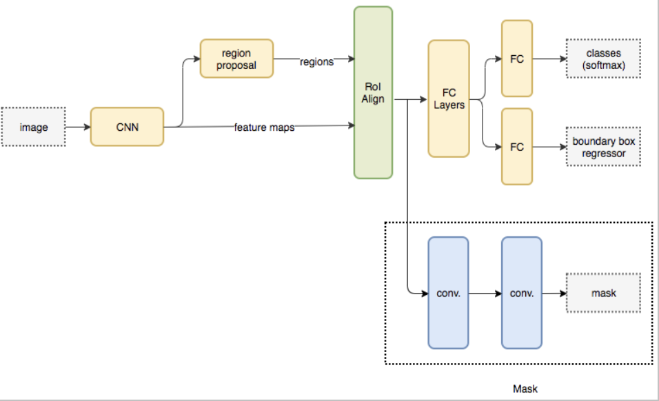
Loss
Loss for mask term

Slide 14
Experiment
details

Slide 15
Experiment
train 15k
Dataset:
coco 2014
validation 5k
Yolo:
https://github.com/ultralytics/yolov3
PyTorch 1.0
Mask RCNN:
https://github.com/multimodallearning/pytorch-mask-rcnn
PyTorch 0.4, CUDA 9.0
Notes:
Different version bring trouble when building and running

Slide 16
Experiment
Two-stage instead of end-to-end training
bbox
feature maps
Mask
Branch
13x13
26x26
52x52

Slide 17
Experiment
Bbox coordinates transform
Prediction from YOLO:
(center-x, center-y, w, h)
NMS:
(x1, y1, x2, y2)
Pyramid_ROI_align:
(y1, x1, y2, x2)

Slide 18
Experiment
Different size feature map
feature map in Yolo
feature map in original MaskRCNN
256*256*256
256*128*128
256*64*64
256*32*32
255*52*52
255*26*26
255*13*13

Slide 19
Experiment
Doesn’t match ground truth
Yolo_bbox
m*7
predicted masks
m*28*28
m? n?
Select by IoU
gt_masks
n*w*h
Notes:
# of bbox generated by yolo does match mask’s count in ground truth

Slide 20
Thank you!

